Slide 1
Canvas & Math Placement

Slide 2
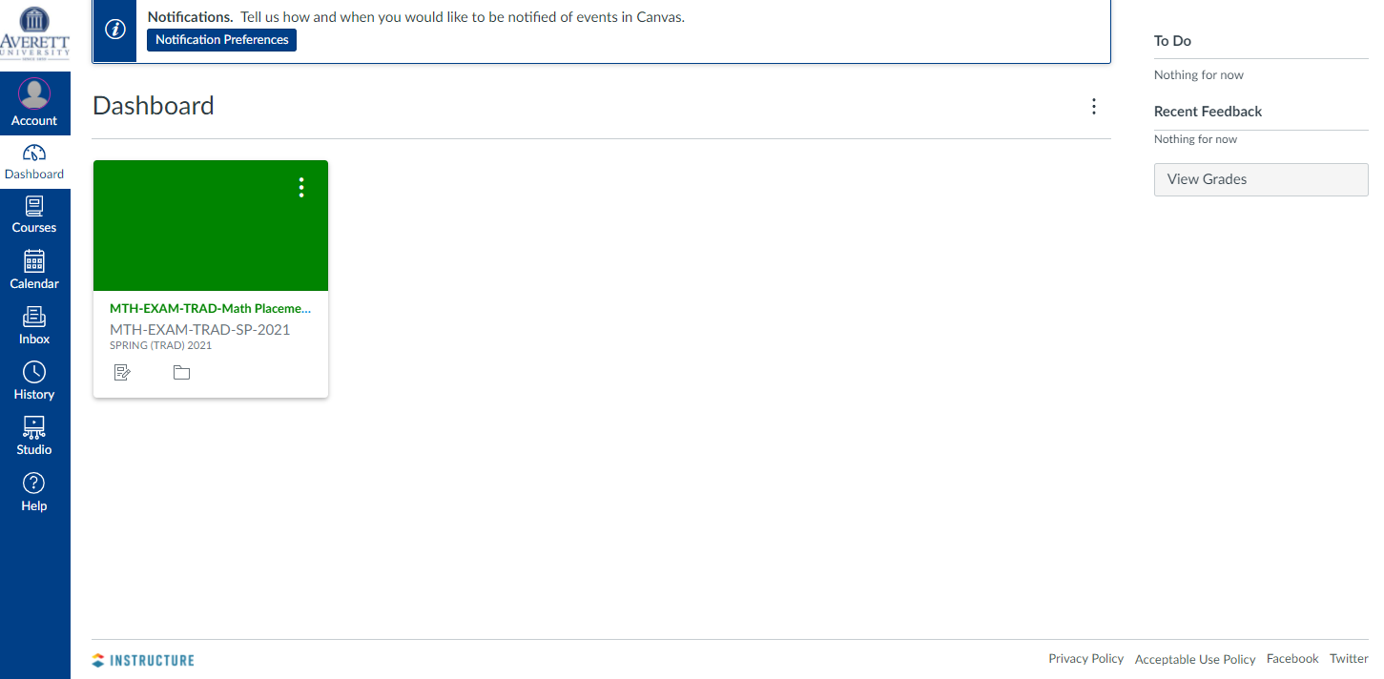

Slide 3
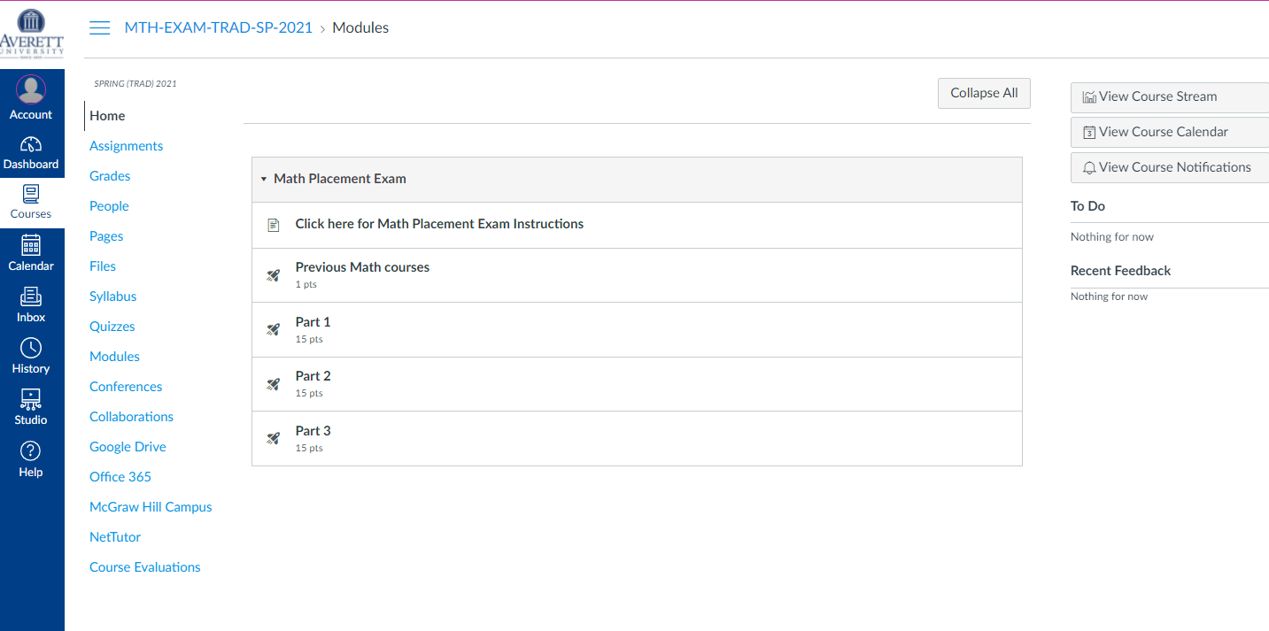

Slide 5
